Slide 1

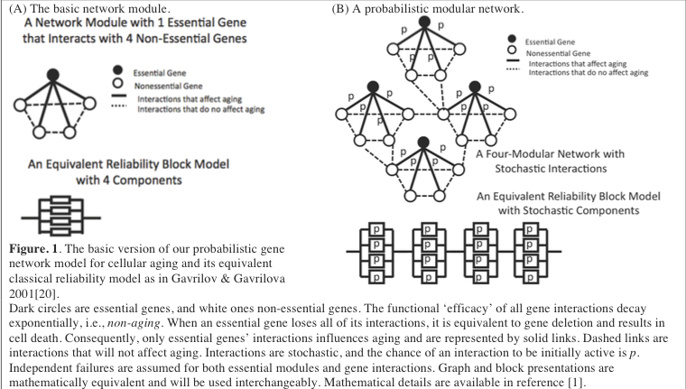
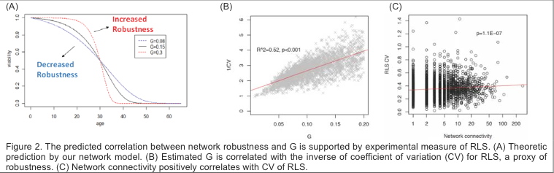
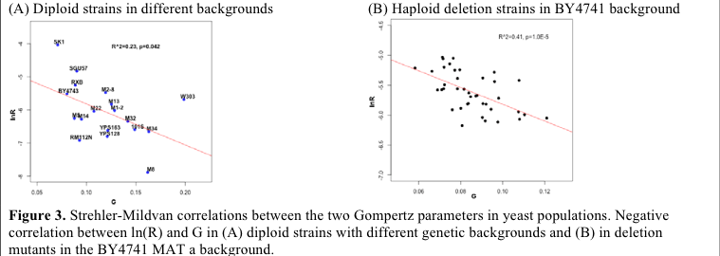
Stochastic Model of Cellular Aging Jessica Corley, Hong Qin Ph.D Spelman College
ABSTRACT
Emergent property of cellular aging is shown by our probabilistic network model
Preliminary Results
The overarching goal of this project is to advance the current knowledge on aging from the perspective of gene networks through integrated research and teaching. Aging is a fundamental question in biology, yet its mechanism remains elusive despite decades of research. Gompertz model describes an exponential increase of mortality rate over time - a ubiquitous feature in biological aging but not in the failures of complex machinery. The stochastic aspect of aging is apparent - Yeast cells from a single colony live to different ages despite their genotypic homogeneity. This coexistence of individual plasticity and a universal demographic characteristic is a puzzling aspect of aging. Hundreds of yeast genes are known to influence lifespan. Paradoxically, not a single gene can be claimed as a direct cause of aging. To complicate things even further, different and even opposite pathways have been observed when yeast aging is measured in dividing or non-dividing cells. This seemingly complicated picture is addressed by the core idea of this proposal - Cellular aging is an emergent property of gene networks. The defining feature of biological aging, exponential increase of mortality rate, can arise from the PI’s network reliability model for cellular aging (NRMCA) with stochastically interacting non-aging components, thereby demonstrating the emergence of cellular aging. The universal negative correlation between the two Gompertz parameters is a prediction of NRMCA. Counter-intuitively, the rate of cellular aging is predicted to be proportional to network robustness and is corroborated by empirical evidences. In this proposal, the PI proposes to advance the current understanding of cellular aging in three directions.
Our core idea is that cellular aging is an emergent property of gene networks. Emergent property generally refers to a feature that can be found only at the system level but not at the component level.
An important property of the model is the Strehler-Mildvan correlation – the trade-off between G and R [30]. It can be shown that ln(R) -BG + Intercept, where B and Intercept are constants based on n, λ, and p. This property explains the universality of the Strehler-Mildvan correlation. Our lab is the first to report this observation in yeast aging, and we have now reaffirmed this observation using many more strains. This kind of universality suggests a common principle and is a key motivation to develop our network model for cellular aging.
The PI has a demonstrated record of yeast aging research, network simulation and analysis, computational and experimental genomics, and mathematical modeling. The PI’s group published the first quantitative study on yeast aging using the Gompertz model and reported the Strehler-Mildvan correlation in yeast.
One interesting prediction is the counter-intuitive positive correlation between the The number of active interactions per gene can be viewed as a measure of network robustness. Hence, stronger robustness would lead to a faster rate of aging.
The basic version of our model contains m number of essential modules, and each module contains 1 essential and n non-essential genes (Figure 1). Stochastic gene interactions follow a binomial distribution, and the chance of a gene interaction to be active is p. The functional efficacy of each interaction is assumed to be non-aging and decays exponentially with a constant rate of . Death of a cell occurs when an essential gene loses all of its interactions, equivalent to deletion of an essential gene. When failures of modules are independent, analytic approximation for the network mortality rate is:
Network Mortality Rate: μnet(t)=R(1+t/t0)n−1 ≈ ReGt when t <<1/ λ,
and
Initial Mortality Rate Gompertz Coefficient (Rate of Aging)
Initial Virutal Age
R=cmnpλ(1−p)n−1 , G = n−1 = λp(n−1),
t0 1− p t0 =1−p / pλ
OBJECTIVES
Objective 1. Study the lifespan-extension mechanisms of dietary restriction using our network model of aging. We hypothesize that DR extends lifespan by increasing reliability of gene interactions. We will fit the network model to replicative lifespan measures in various yeast mutants and treatments, and use their fitting parameters and likelihoods to evaluate five major pathways for DR.
Objective 2. Study the role of network organizational patterns in network aging. We will use both analytic and simulation approaches to study the power-law configuration and error tolerant features of the yeast gene network.
Our educational objective is to integrate the proposed computational and experimental research into undergraduate education at a historically black college for women, to engage minority students in high-performance computing and network biology, and to address the urgent needs for training future quantitative biologists.
These objectives are based on the PI’s experiences, expertise, previous and preliminary findings, and significance of expected results. The PI has a demonstrated record of studying yeast aging [2-4], network simulation and analysis [5-7], computational and experimental genomics [2, 8-10], mathematical modeling [11] and integrating research into teaching [12, 13].
Brief introduction of quantitative models of aging
ACKNOWLEDGEMENTS
Aging is a fundamental question in biology. Aging of an organism or a system can be described by the mortality rate μ(t), which is the normalized declining rate of viability S(t) over time t:
Mortality rate : μ(t) = − 1 dS(t) (Eq. 1) S(t) dt
Aging occurs when μ(t) is a positive increasing function that indicates increasing chance of dying over age. Mortality rate is also known as the force of mortality, failure rate or hazard rate in various contexts. In general, μ(t) can be a power function for machine aging and an exponential function for biological aging.
An organism can be non-aging when μ(t) is a constant in Eq. 1. In this case, drop of viability becomes an exponential decay, which is basically a first-order chemical reaction, just like the exponential decay of radioactive isotopes. Individuals from these populations are as good as new at any time point, and are therefore non-.aging.
This study was supported by grants from the Howard Hughes Medical Institute 52006314 and NSF award #1453078.
CITATIONS
1. Gavrilov, L.A. and N.S. Gavrilova, The reliability theory of aging and longevity. J Theor Biol, 2001. 213(4): p. 527-45.
2. De Paepe, M. and F. Taddei, Viruses' life history: towards a mechanistic basis of a trade-off between survival and reproduction among phages. PLoS Biol, 2006. 4(7): p. e193.
3. Gompertz, B., On the Nature of the Function Expressive of the Law of Human Mortality, and on a New Mode of Determining the Value of Life Contingencies. Philosophical Transactions of the Royal Society of London, 1825. 115: p. 513-585.

